Slide 1
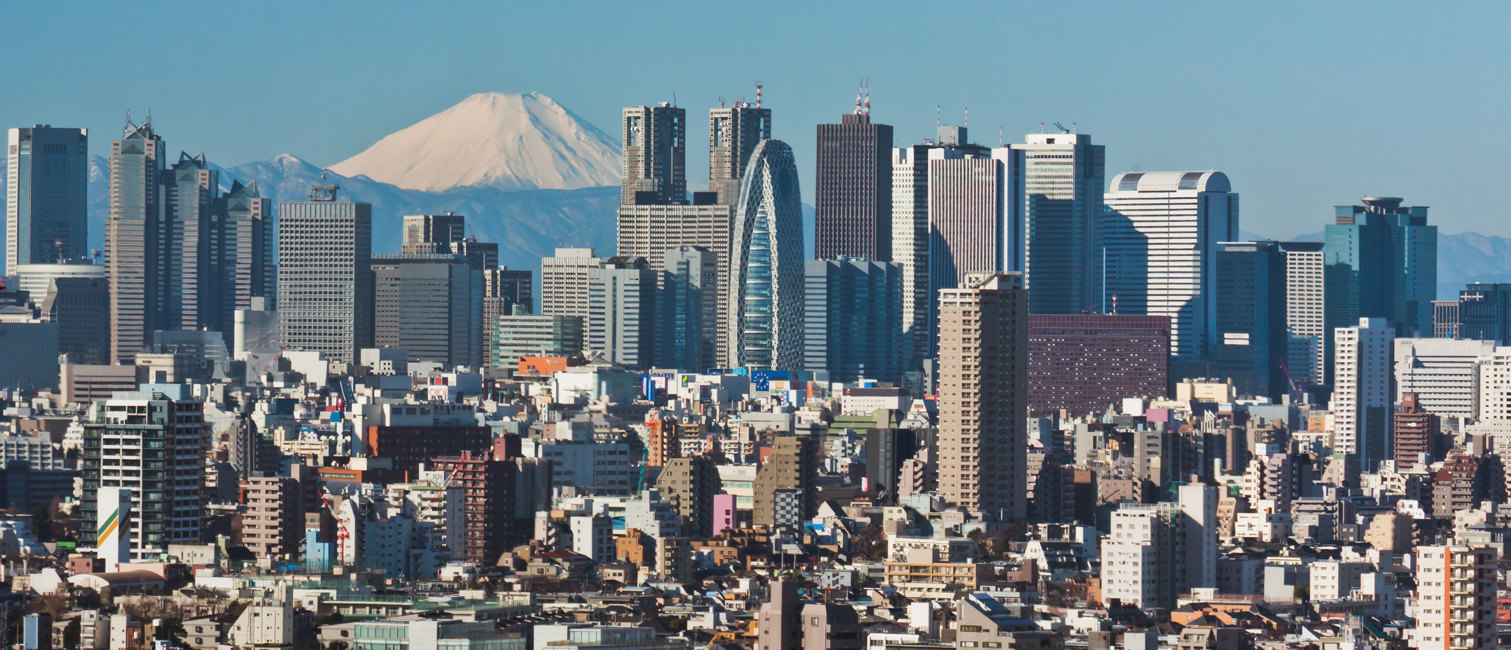
UF in Japan Study Abroad
Immerse Yourself in the Culture and Explore the Eastern Approach to the Built Environment
Faculty-Led Study Abroad
Locations: Tokyo, Nagoya, Osaka, and Kyoto
Japanese Proficiency Not Required
Dates: May 5 – 19, 2025
For more information contact:
Dr. Walters or Sullivan
rwalters@ufl.edu

